Slide 1
oTree workshop
Philipp Chapkovski
Higher School of Economics, Moscow
January 30

Slide 2
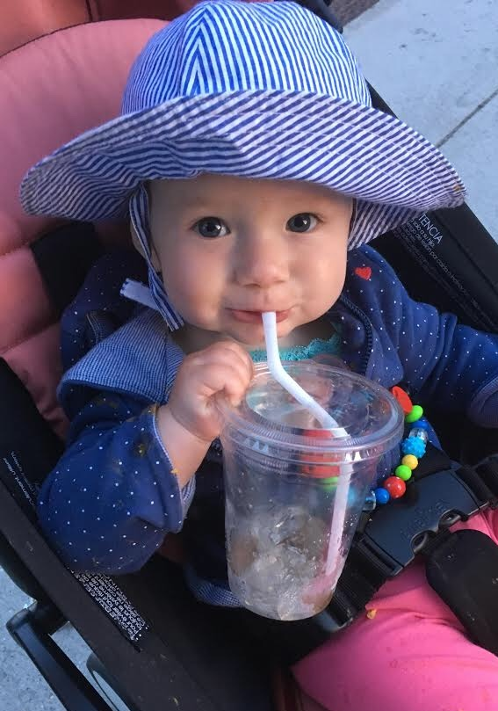
About, Demo and plans for today
Post-doc in International Laboratory for Experimental and Behavioural Economics (https://epee.hse.ru/en/, chair of Heike Hennig-Schmidt)
https://zurich-workshop-2018.herokuapp.com/demo/
!! Get familiar with oTree Admin
Public good game with two treatments and interaction:
Heterogeneous endowments
Gender information about co-members

Slide 3
oTree: alternatives
Lioness http://lioness-lab.org/ - G34, gm15, (Gaechter et al. 'Conducting interactive experiments online' 2018 Experimental Economics)
NodeGame nodegame.org (G8, gm27, 47 Stars, 6 Forks on GitHub)
Gorilla gorilla.sc, proprietary, see paper in PsyArXiv 2018
Sophie https://www.sophielabs.com/ (gm48, Last release 2016)
BreadBoard http://breadboard.yale.edu - Proto stage network project with Christakis (22 Stars, 7 Forks on GitHub)
…
oTree (www.otree.org), (G102, gm890, 219 Stars, 103 Forks on GitHub)

Slide 4
oTree
platform to run interactive online experiments
written on Python
open source
based on Django framework
responsive – can be run in mobile browsers, tablets etc.
oTree support group: | https://groups.google.com/forum/#!forum/otree
oTree documentation: | http://otree.readthedocs.org/
oTree hub | https://www.otreehub.com/apps/

Slide 5
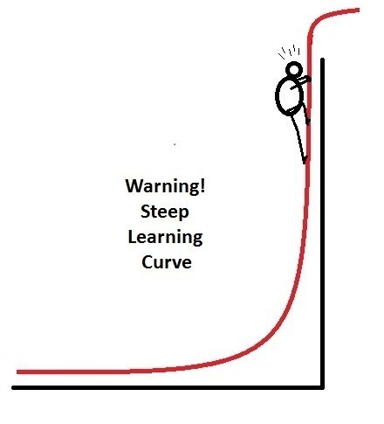
oTree
Languages: Python (backend); HTML, JavaScript, Django template language (frontend)
Backend: Django (M-V-C)
CBV, Abstract models
Frontend: Bootstrap
(https://getbootstrap.com)

Slide 6
Some more complicated examples
Double auction
https://double-auction.herokuapp.com
Employer-employee negotiations
https://negotiations-otree.herokuapp.com
English auction
https://mini-ebay-otree.herokuapp.com/
Information cascade
https://information-cascade-otree.herokuapp.com/
Real effort tasks
https://morning-citadel-36858.herokuapp.com

Slide 7
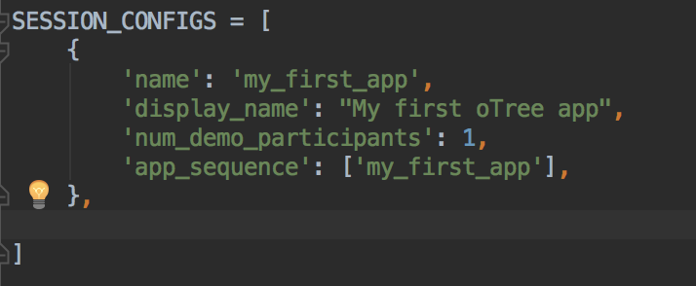
Let’s create our first oTree app
RECOMMENDED: Create virtualenv
T: pip install –U otree
T: otree --version
T: otree startproject my_first_project
T: cd my_first_project
T: otree startapp my_first_app
add app to settings
T: otree devserver
Browser: go to: http://127.0.0.1:8000

Slide 8


Our main goal:
Show something to the participant.
Get his/her/other reaction on it

Slide 9
Models
Pages
Templates

Slide 10
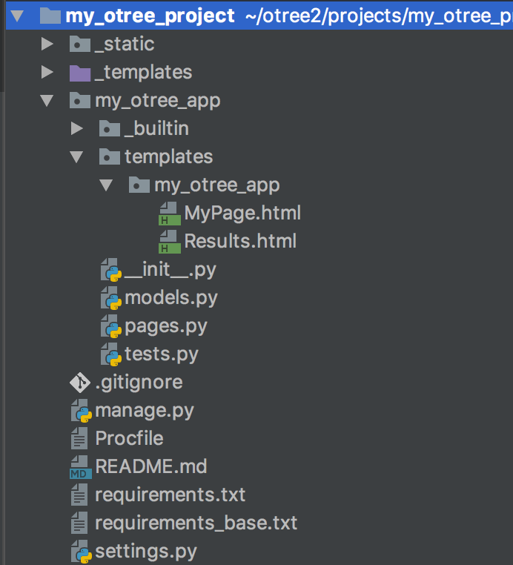

Slide 11
Structure of oTree app
Pages
Page classes
page_sequence
Models
Constants
Player, Group, Subsession
App definition in settings.py
Displaying logic
Data processing

Slide 12
Models are responsible for storing and processing data in the database
Anything that you need to be stored should be defined as a field in models.py file
Models
Pages
Templates

Slide 13
Pages are responsible for retrieving and passing back data from models to templates and vice versa.
If you need to show something to a participant or to get his/her input, you need to indicate this in pages.py
Models
Pages
Templates

Slide 14
Templates are just "ordinary" html files which get the info from pages and show it to a participant.
As soon as a participant clicks ‘Next’ the data he enters is passed back to pages which pass them further to models
Models
Pages
Templates

Slide 15

One session can contain several apps

Slide 16
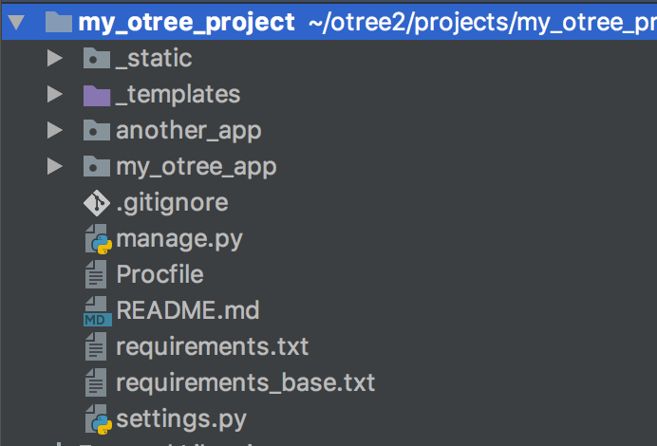
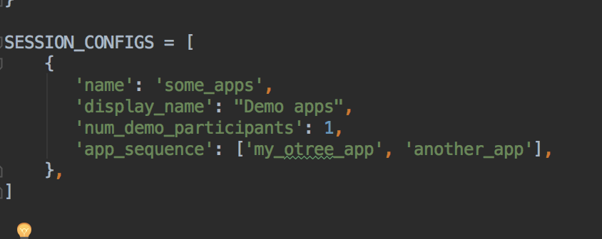
One session can contain several apps
in settings.py:

Slide 17
This is session.
The entire set of all participants in your lab
or online

Slide 18
This is participant.
The entire set of all participants in your lab
or online

Slide 19
Subsession
is a set of all players in one round

Slide 20
Player is an element of
subsession

Slide 21
One participant
contains the info
about all players
who he/she
‘owns’

Slide 22
The group
is a set of players
in one particular
subsession

Slide 23
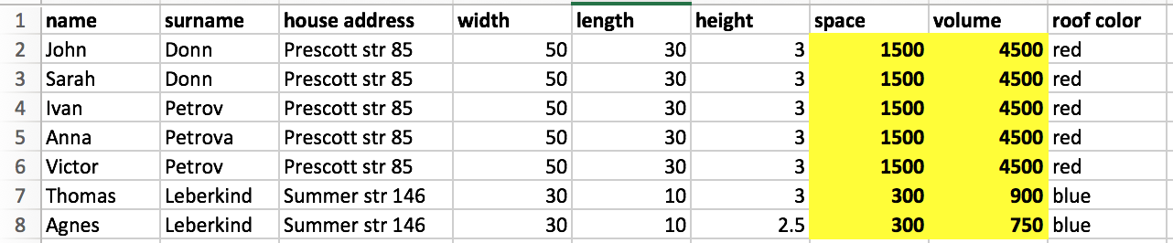
ForeignKey relational databases
we can split the data sheet into two tables (Persons, Houses) and the information stops being redundant

Slide 24
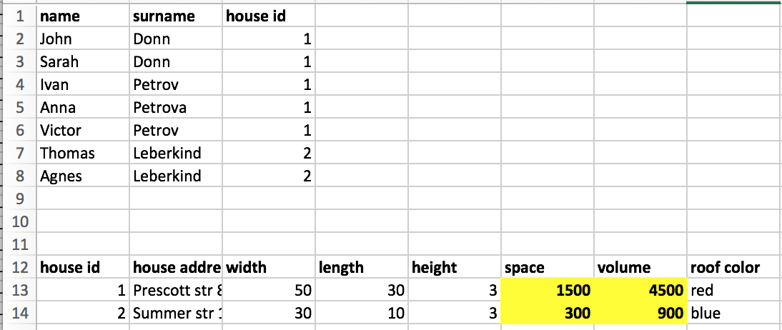
ForeignKey relational databases
we can split the data sheet into two tables (Persons, Houses) and the information stops being redundant

Slide 25
Django Database structure
Subsession
Participant
Session
Group
Player

Slide 26
ForeignKey relational databases
class definition: structure of the data:
class instance: the specific ‘record’ of the data
'self' refers to the attribues/methods of the same 'row'==instance

Slide 27
Django ORM
from otree.models import Session, Participant
class Intro(Page): def is_displayed(self): cursession = Session.objects.get(pk=self.session.pk) participants = cursession.participant_set.all() for p in participants: print(p.code) # Results in the same output as: for p in self.session.get_participants(): print(p.code)
print(Player.objects.filter(id_in_group__gt=1).values('pk').query)
SELECT "chat_player"."id" FROM "chat_player" WHERE "chat_player"."id_in_group" > 1

Slide 28
Anatomy of models.py
Constants: game parameters that stay the same for all players
Subsession: parameters that stay the same for all participants in specific round
Group: data/parameters that stay the same for all members of one group in specific round
Player: data/parameters that are unique for each player in a specific round

Slide 29
Anatomy of an oTree Page
Page creation:
class definition
template
When/if/for whom it is shown:
position in page_sequence
is_displayed method
What is shown:
vars_for_template method
What to do next:
before_next_page method

Slide 30
anatomy of oTree
every page (and many views in Django) has get and post methods
They are executed when a page is shown, and when the form is submitted correspondingly
on get oTree checks the is_displayed and redirects further if it is false
on post oTree checks the errors in a form, executes before_next_page and redirects further

Slide 31
Methods of an oTree Page/WaitPage
BEFORE page is shown:
is_displayed (should return True if page is to be shown)
vars_for_template
AFTER page is shown:
before_next_page
WAITPAGE:
after_all_players_arrive method

Slide 32
First step: information about gender
Creating app (pgg?)
models.py: Model field (gender?)
pages.py: new page class (Gender?)
pages.py: add class to page_sequence
Templates folder: pgg/Gender.html
…
DONE!

Slide 33
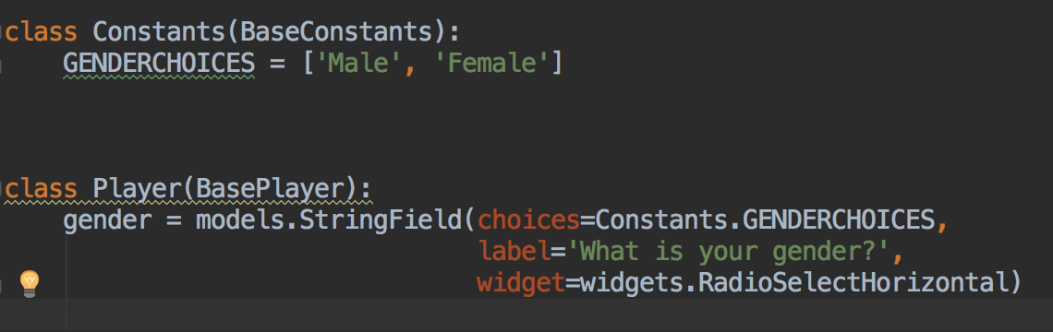
models.py – field definition
You can write your own fields and widgets

Slide 34
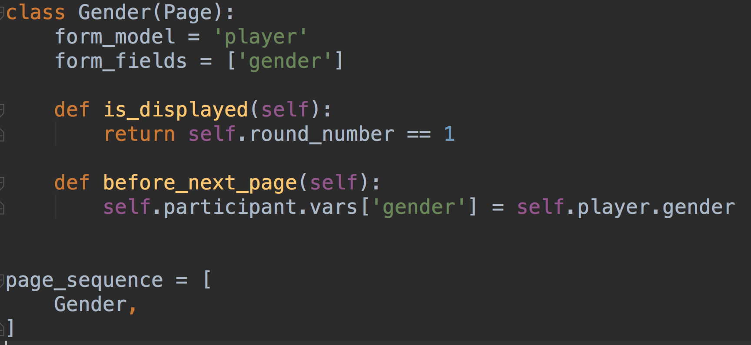
Anatomy of an oTree Page
WHY?
You can subclass pages

Slide 35
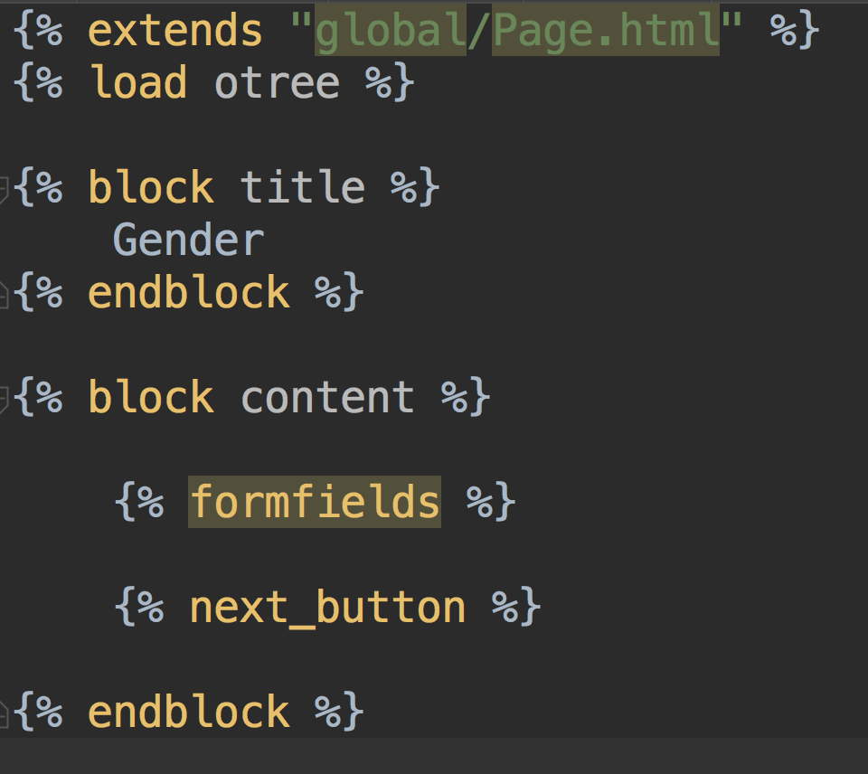
Gender.html template

Slide 36
Templates: using variables
In a template you can access variables defined in vars_for_template of the specific page:
{{ var }}
You can also use lists and dictionaries and custom methods!
You can also access any variable in Constants, Player, Group…
{{ Constants.players_per_group }}
{{ player.payoff }}

Slide 37
Templates: loops, conditions
You can use conditions and loops in templates:
{% if player.age < 30 %}
hi, dude!
{% else %}
Dear Mr. Player,
{% endif %}

Slide 38
Templates
to include another file (for example instructions):
{% include ‘path_to_file/name_of_file.html %}
to make ‘Next button’: {% next_button %}
Otree_tools also allow for some extratags: tracking_focus, confirm_button, etc.
You can write your own tags!
You can subclass the pages as you do with the classes

Slide 39
Static files: images, css, javascript
in Static folder create a folder with your appname
<img src="{% static ”appname/myimage.png" %}"/>

Slide 40
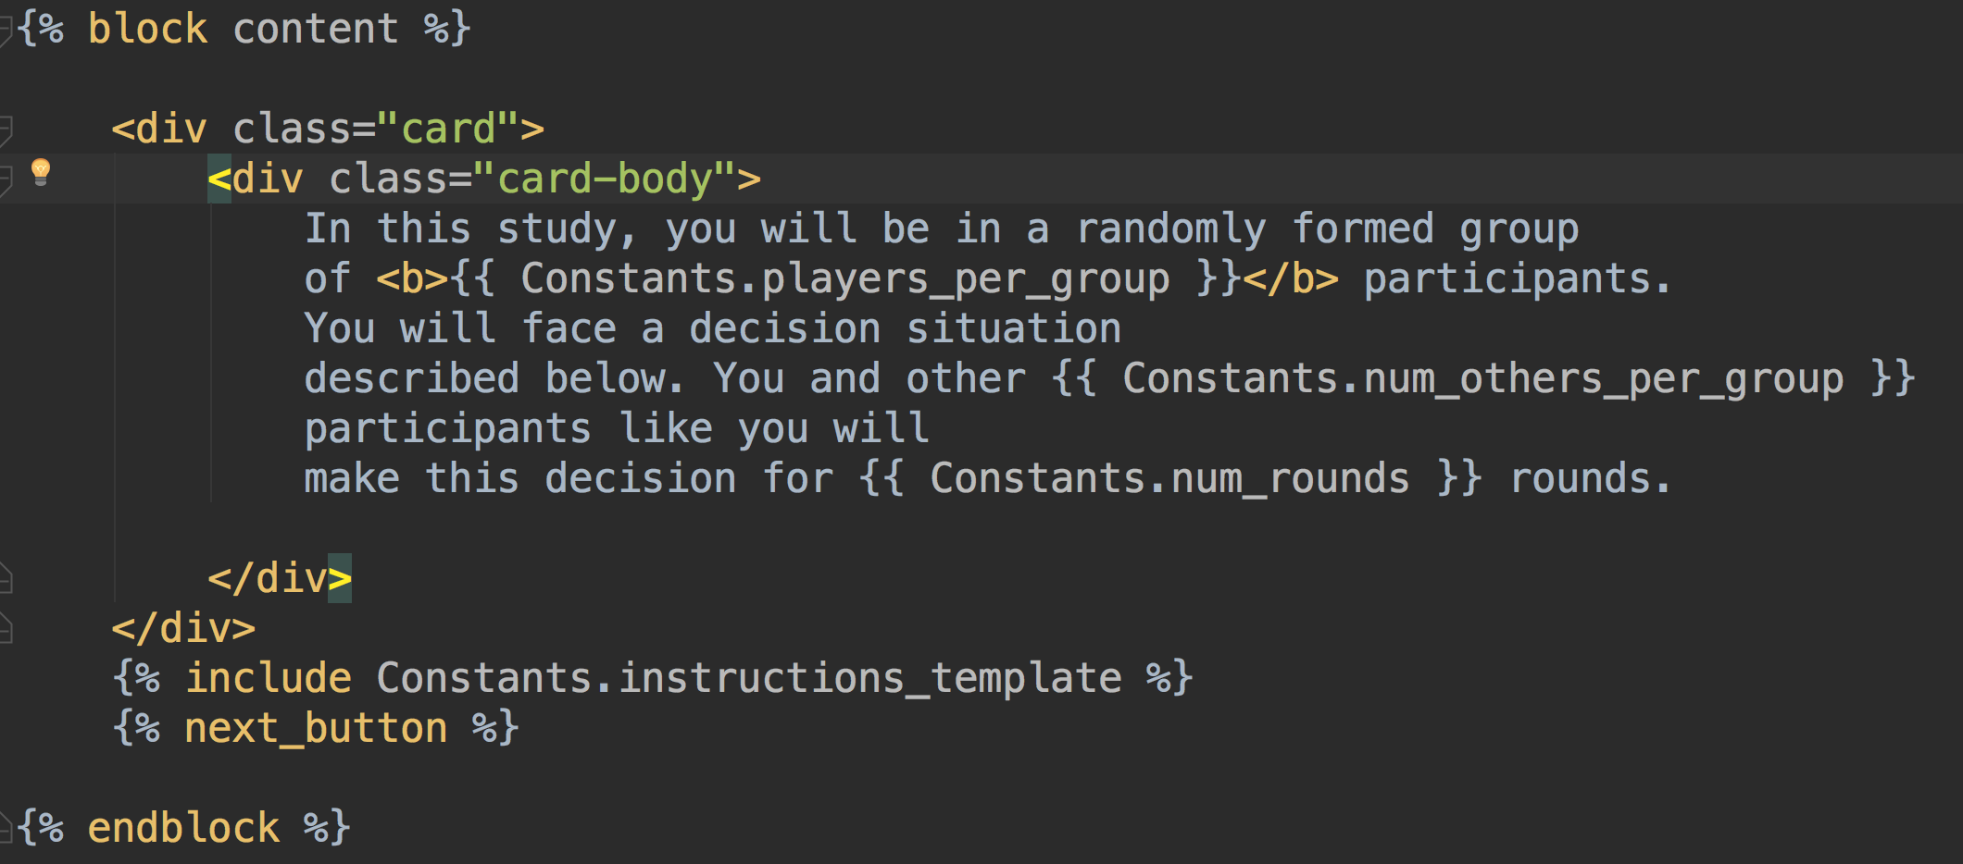
Templates
WHY?

Slide 41

GIT
Get GitHub Education!
git init
git add .
git commit –m 'Commit message'
git add remote origin <LINK_TO_GIT>
git push origin master
rolling back: git checkout <COMMIT_ID> .
git stash
git pull origin master
More info: http://rogerdudler.github.io/git-guide/

Slide 42
Heroku
create git first!
heroku create <APP_NAME>
heroku addons:create heroku-redis
git push heroku master
heroku run otree resetdb
heroku config
RECOMMENDED: oTree Hub (www.otreehub.com)

Slide 43
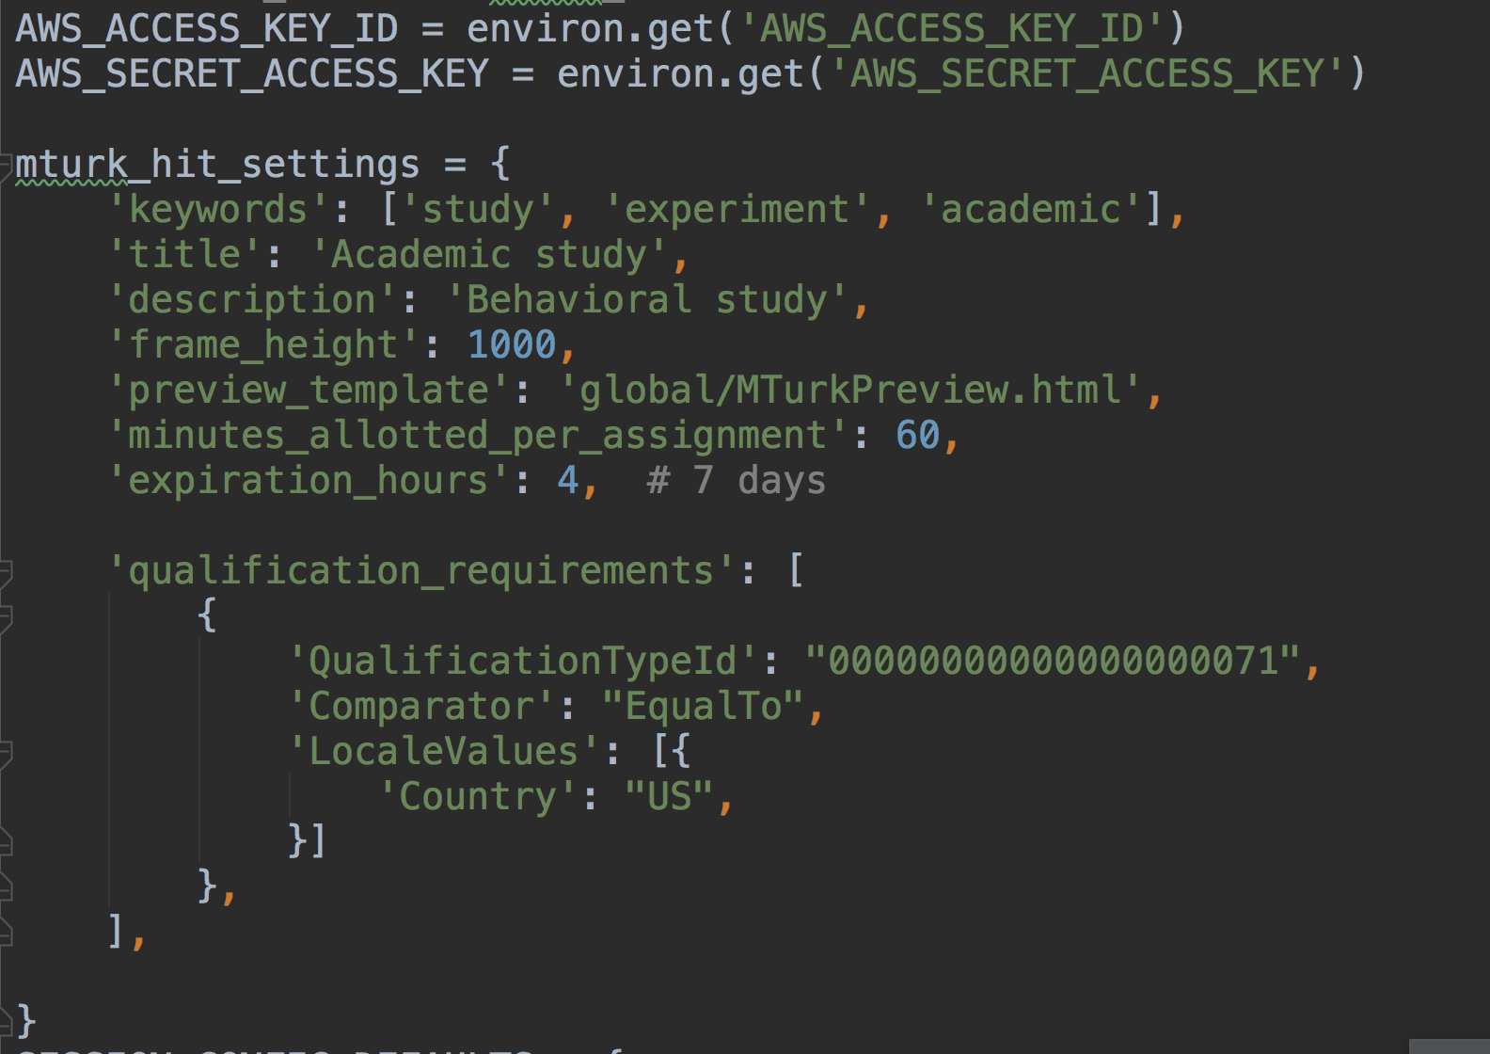
Posting experiments on mTurk

Slide 44
Creating new app
open terminal
change directory to my_first_project folder
type: otree startapp pgg
Open the PyCharm
add the pgg into settings.py:
SESSION_CONFIGS = [ { 'name': 'pgg', 'display_name': "Public Good Game", 'num_demo_participants': 3, 'app_sequence': ['pgg'], }, ]

Slide 45
Conditions on showing pages
class Intro(Page): def is_displayed(self): return self.round_number == 1 ... class FinalResults(Page): def is_displayed(self): return self.round_number == Constants.num_rounds

Slide 46
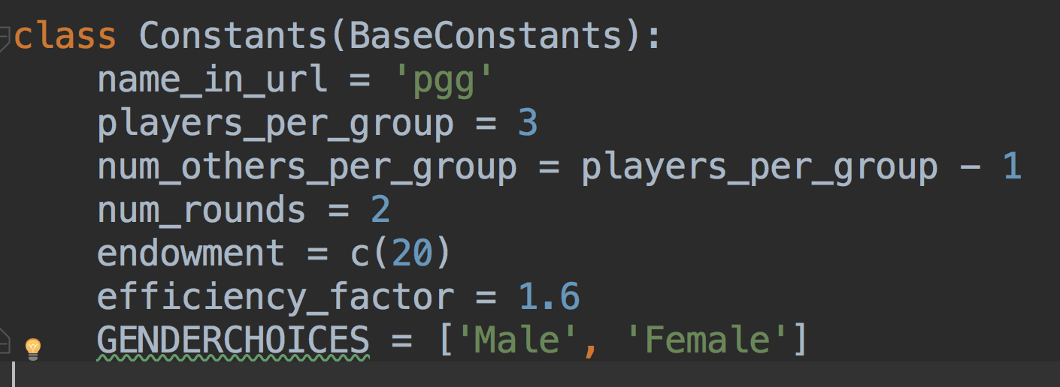
Constants

Slide 47
Contribution decision
in pages.py:
class Contribution(Page): form_model = 'player' form_fields = ['contribution']
in template Contribution.html:
<h4>How much you would like to invest to a common group project:</h4> {% formfield player.contribution label='' %}

Slide 48
Payoff calculation line by line
self.total_contribution = sum([p.contribution for p in self.get_players()])
self.get_players() – is a method of a Group, that returns the list of all players in this group
we can loop through it obtaining or assigning values for each player in a group
so this line returns us a list of all contributions of players in a group
we assign a sum of these contributions to a group variable total_contribution

Slide 49
Obtaining data from other players
self.group.get_players()
self.player.get_others_in_group()
self.group.get_player_by_role(‘ROLE_NAME’)
self.group.get_player_by_id(‘ID’)
total_contribution = sum([p.contribution for p in self.get_players()])

Slide 50
Obtaining data from previous rounds
participant.get_players()
participant.payoff
player.in_all_rounds()
player.in_previous_rounds()
player.in_round(x)
player.in_rounds(x,y)
on template:
{{player.round_number}}
on page:
self.round_number

Slide 51
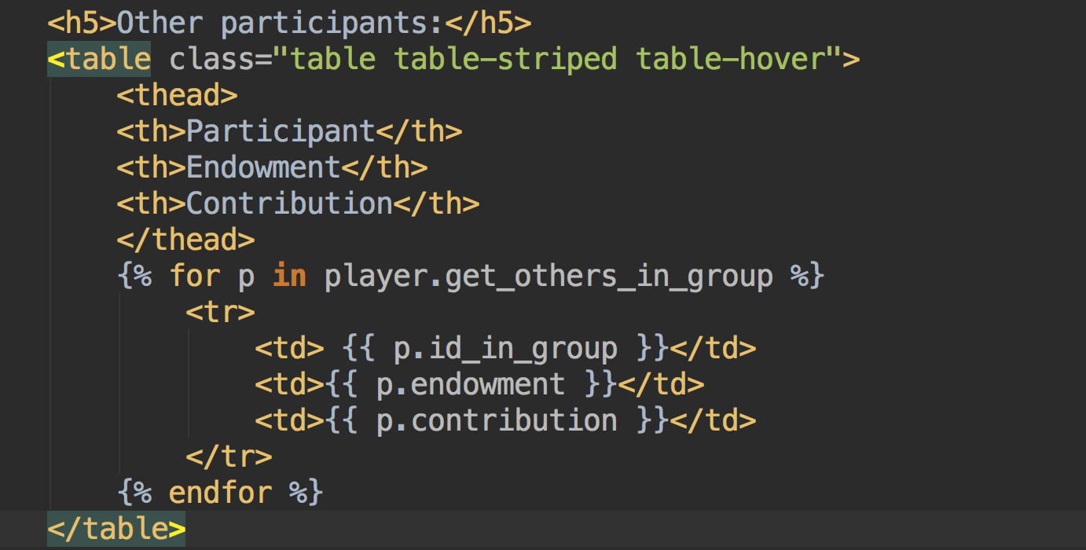
Results: other players
Special method: self.player.get_others_in_group()

Slide 52
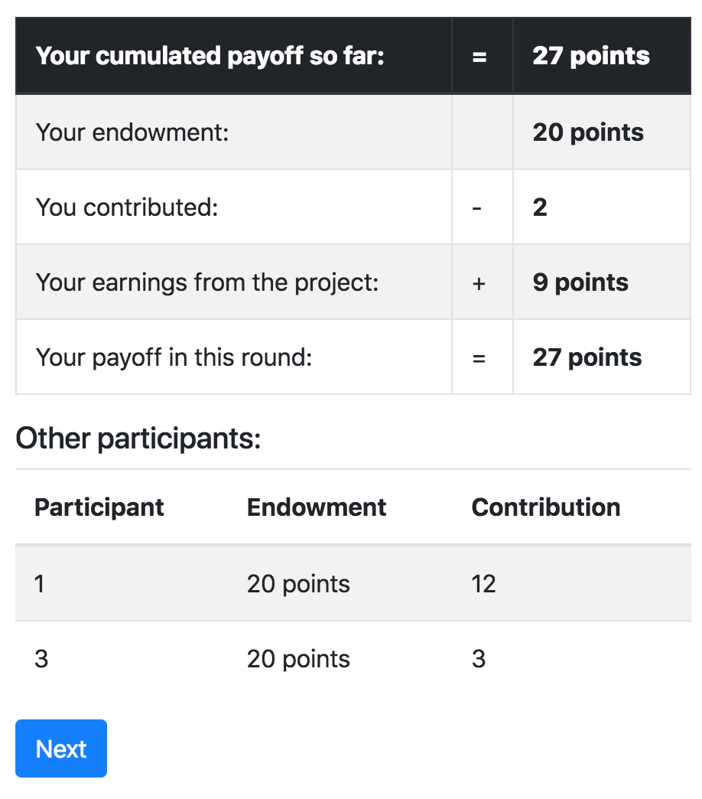
Results: showing previous rounds

Slide 53
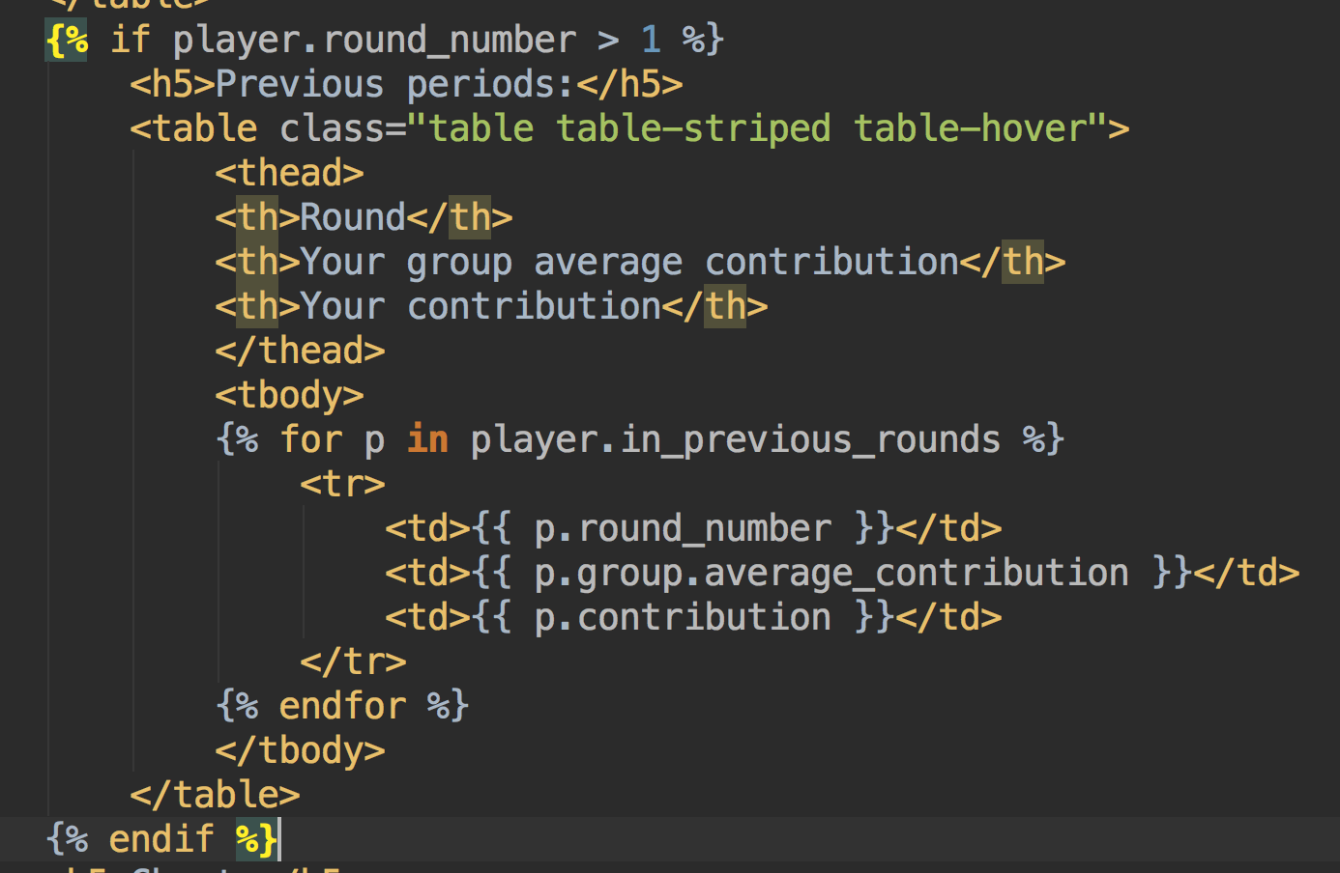
Average group contributions across rounds

Slide 54
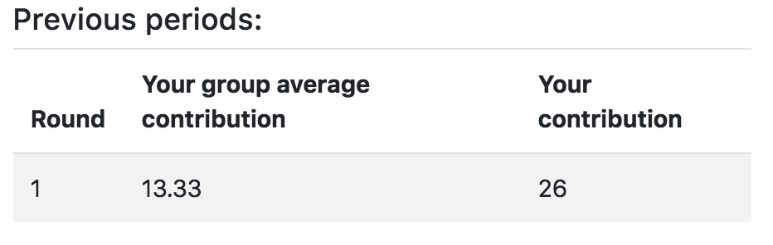
Results page:

Slide 55
Final results:
We need to show the payoffs of a particular player in each round.
And the total payoff for the entire game

Slide 56
Treatments
Create two different treatments of Public Good game:
1. Baseline treatment
2. Endowment_heterogeneity: treatment with heterogeneous endowments (each player has his/her own randomly generated endowment).
3. Gender_info:Treatment where gender info of other participants is shown
4. Gender_info X Endowment_heterogeneity treatment

Slide 57
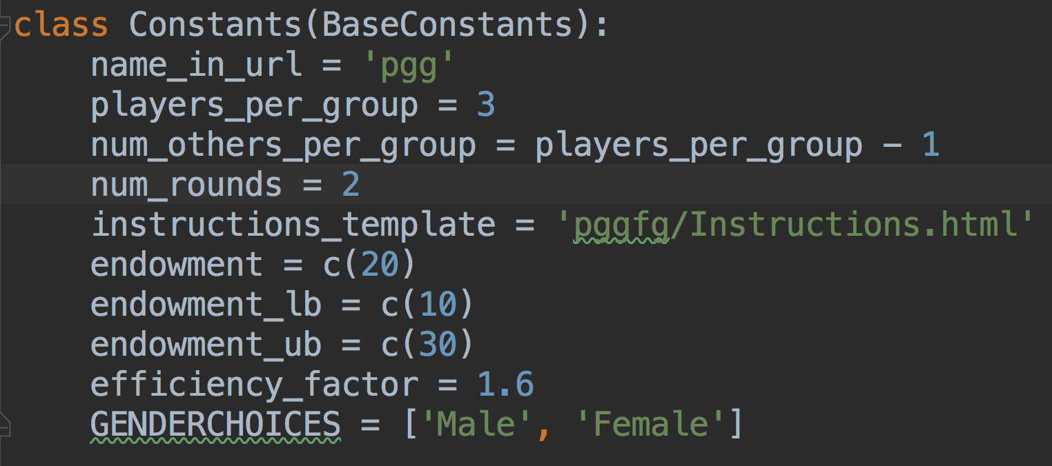
Updated constants:

Slide 58
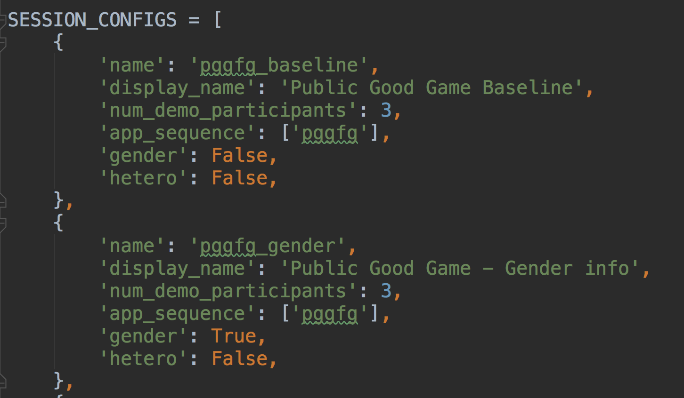
Configurating session

Slide 59
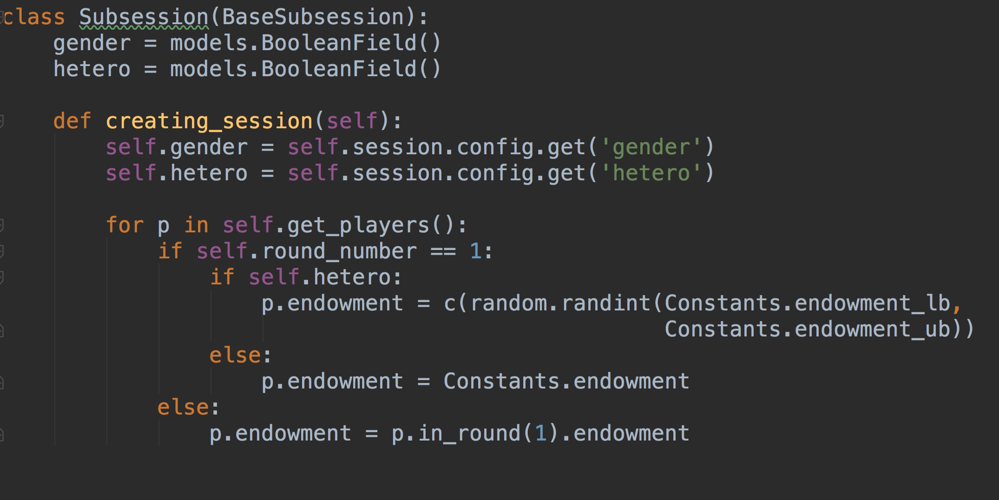
Generating treatment info

Slide 60
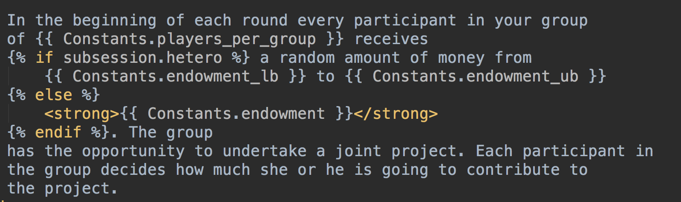
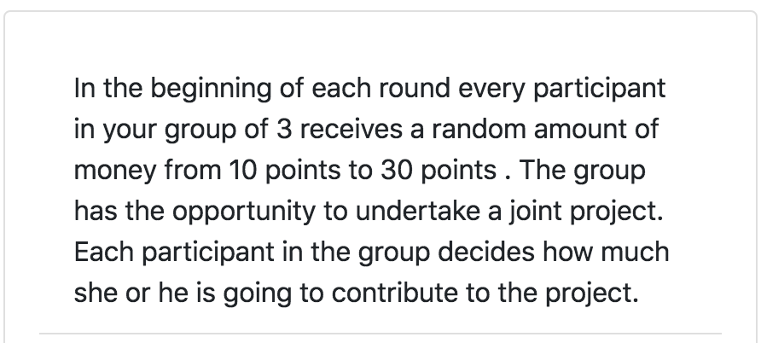
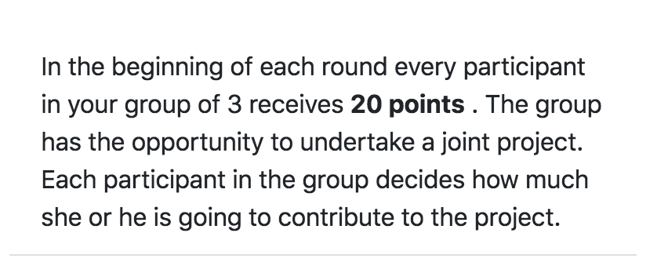
Making instructions flexible

Slide 61
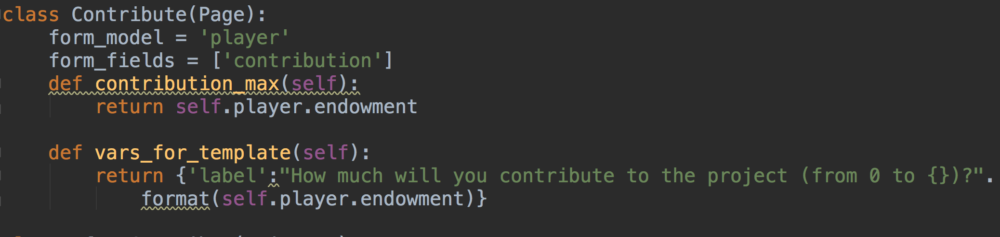
Dynamic min/max

Slide 62
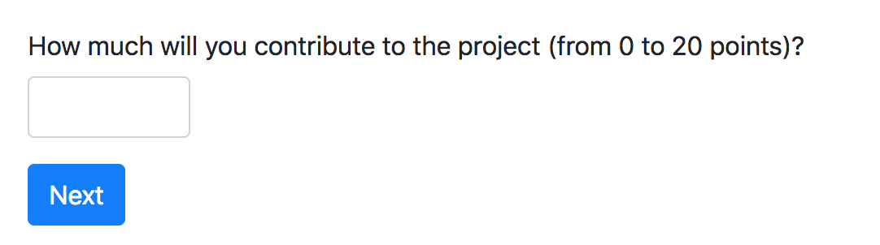
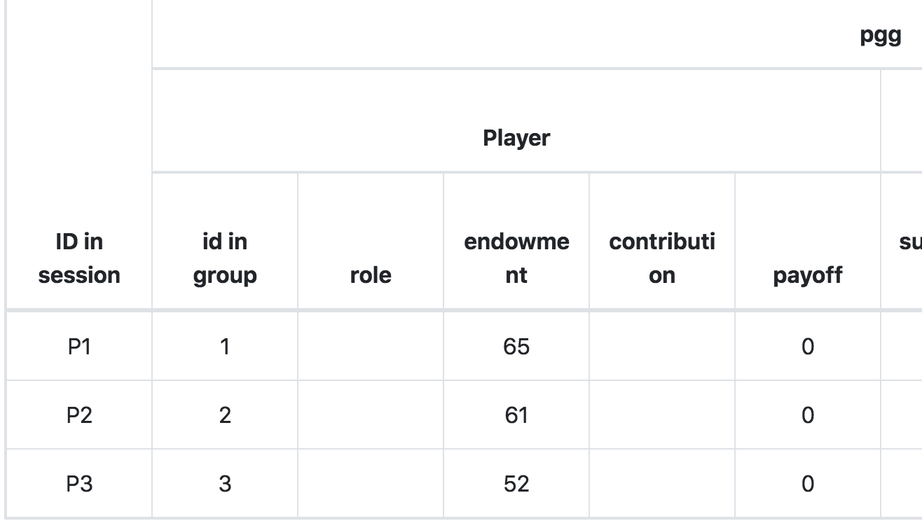
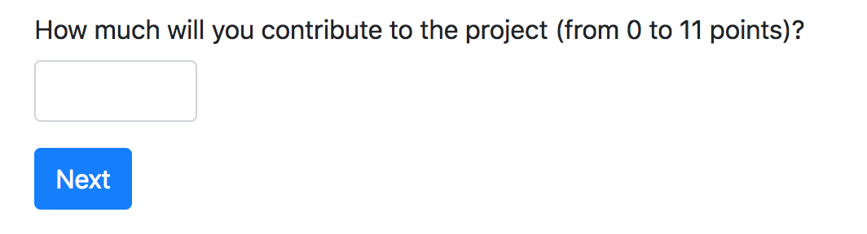
Resulting data

Slide 63
timeouts
class MyPage(Page):
form_model = ‘player’
form_fields = [‘accept’]
timeout_seconds = 600
timeout_submission = {'accept': True}
def before_next_page(self):
if self.timeout_happened:
self.player.accept = random.choice([True, False])

Slide 64
shuffling players
Subsession:
group_randomly()
group_randomly(fixed_id_in_group=True)
group_like_round()
set_group_matrix(), self.get_group_matrix()
Group:
set_players()
get_players
GBAT: group_by_arrival_time()

Slide 65
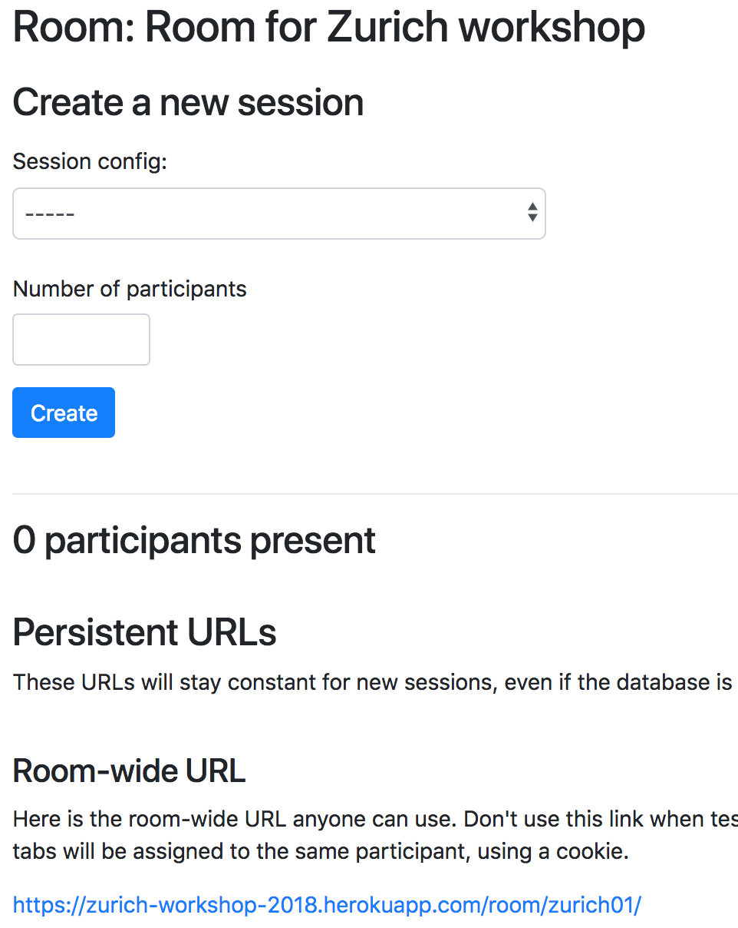
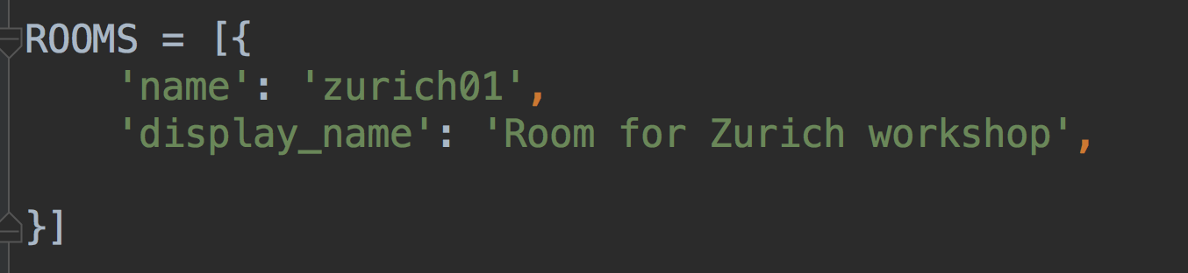
Rooms:

Slide 66
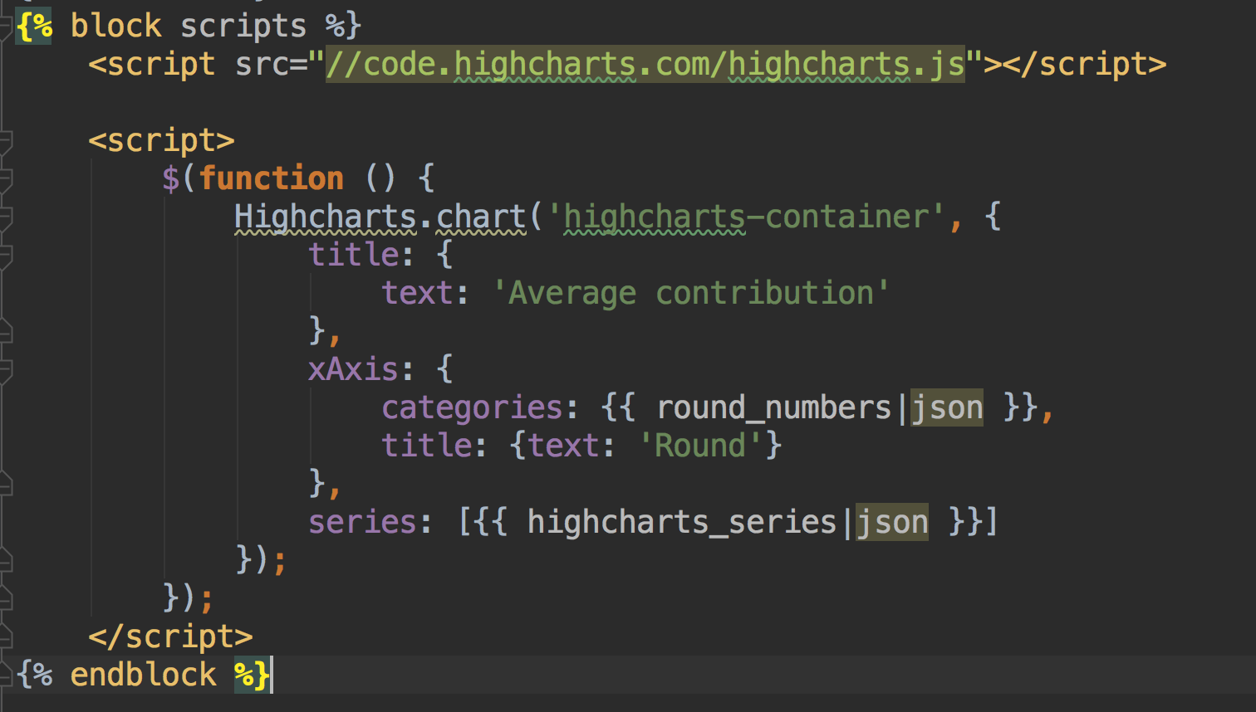
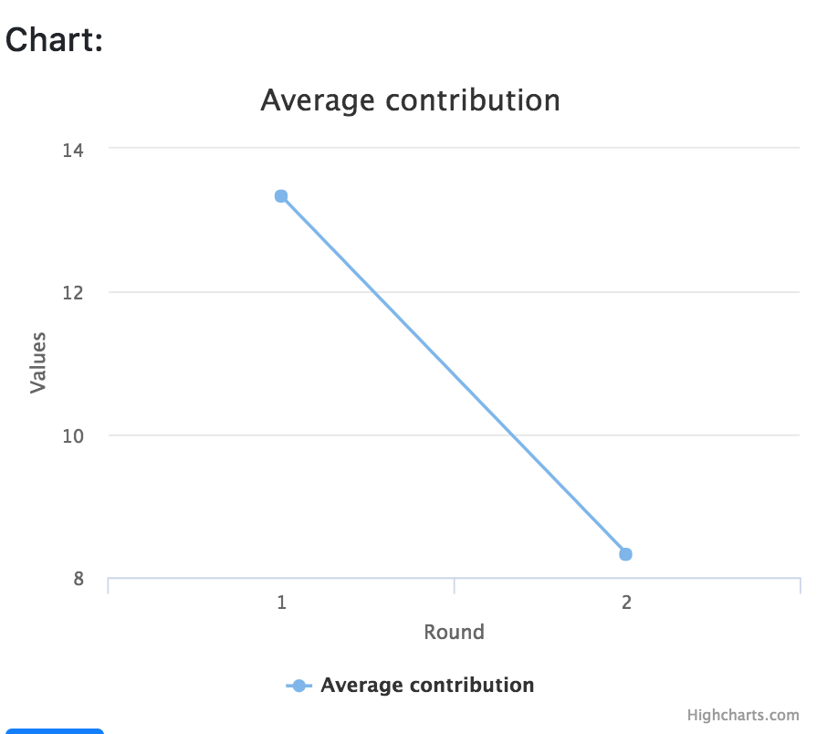
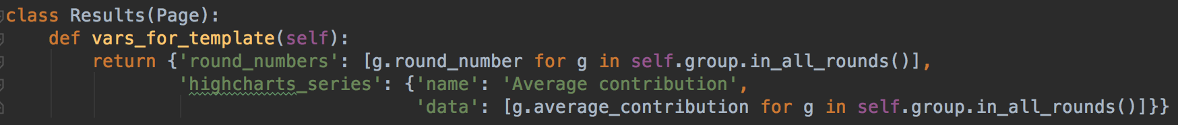
Charts

Slide 67
oTree extensions and add-ons
otreeutils
otree-tools
oTree Hub (www.otreehub.com)
oTree-manager:
Demo: http://demo.otree-manager.com
Documentation http://docs.otree-manager.com
Code: https://github.com/chkgk/otree_manager
oTree Virtual Machine Manager:
Documentation: https://otree-virtual-machine-manager.readthedocs.io/

Slide 68
Dynamic set of forms
in Page class:
class MyPage(Page):
def get_form_fields(self):
if self.player.treatment == ‘A’:
return [‘a’, ‘b’]
else:
return [‘c’, ‘d’]

Slide 69
Dynamic set of choices
you have a field fruit
in Page class:
import random
class MyPage(Page):
def fruit_choices(self):
choices = ['apple', 'kiwi', 'mango']
random.shuffle(choices)
return choices

Slide 70
Randomizing treatments
class Subsession(BaseSubsession): def creating_session(self):
if self.round_number == 1: for p in self.get_players(): p.treatment = random.choice([‘A’,’B’]
for g in self.get_groups() g.treatment = random.choice([‘A’,’B’]
else:
for p in self.get_players(): p.treatment = p.in_round(1).treatment

Slide 71
Roles
class Player(BasePlayer): def role(self): if self.id_in_group==1: return 'dictator’ else: return 'receiver’
role() is a method of a Player’s model
we can use id of a player within a group to assign roles
…. or any other logic

Slide 72
Conditional view based on role
class Decision(Page): form_model=group' form_fields = ['dg_decision'] def is_displayed(self): return self.player.role() == 'dictator'
is_displayed is a method built-in in a Page
by default it is shown to all players
if under certain condition it returns False, it is skipped

Slide 73
Question randomization
class Constants(BaseConstants): qs_a = ['political_views', 'trust'] qs_b = ['experimenter_demand', 'gender'] question_sets = [qs_a, qs_b]
class Subsession(BaseSubsession): def creating_session(self): if self.round_number == Constants.num_rounds: for p in self.get_players(): qs = Constants.question_sets.copy() for i in qs: random.shuffle(i) random.shuffle(qs) p.qs_order = json.dumps(qs)

Slide 74
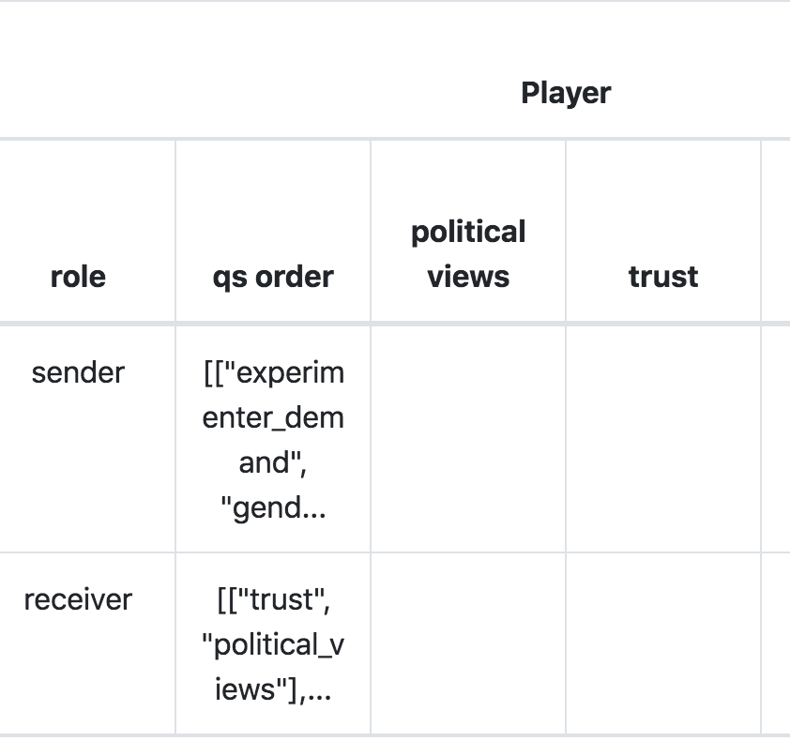
Question randomization
class Survey1(SurveyPage): def get_form_fields(self): return json.loads(self.player.qs_order)[0] class Survey2(SurveyPage): def get_form_fields(self): return json.loads(self.player.qs_order)[1]

Slide 75
More complicated example: SVO
https://github.com/chapkovski/svo
https://svomeasure.herokuapp.com
def get_form_fields(self): qs = ['svo{}dec'.format(i) for i in json.loads(self.player.item_order)] return qs

Slide 76
Back page
def before_next_page(self): if self.request.POST.get('back') == '1': self._index_in_pages -= 2 self.participant._index_in_pages -= 2

Slide 77
getattr, setattr, adding several fields in a row
for i in range(10): Player.add_to_class(f'a{i}', models.IntegerField())
getattr(Player, 'a1')
setattr(Player, 'a1', 1)
getattr(Player, 'a1')

Slide 78
Minor things
get_FOO_display from choices

Slide 79
Inheriting templates
{% extends "global/Page.html" %} {% load otree static %} {% block global_styles %} {% endblock %} {% block global_scripts %} {% endblock %} {% block content %} {% block inner_content %} {% endblock %} <div class="m-5"> {% next_button %} </div> {% include 'global/footer.html' %} {% endblock %}
{% extends "global/PageExt.html" %} {% load otree static %} {% block title %} Intro 1 {% endblock %} {% block inner_content %} <div>Something here - intro</div> {% endblock %}

